Slide 1
WELCOME TO HALSEY
This website is Created by RISHMA from C S E department

Slide 2
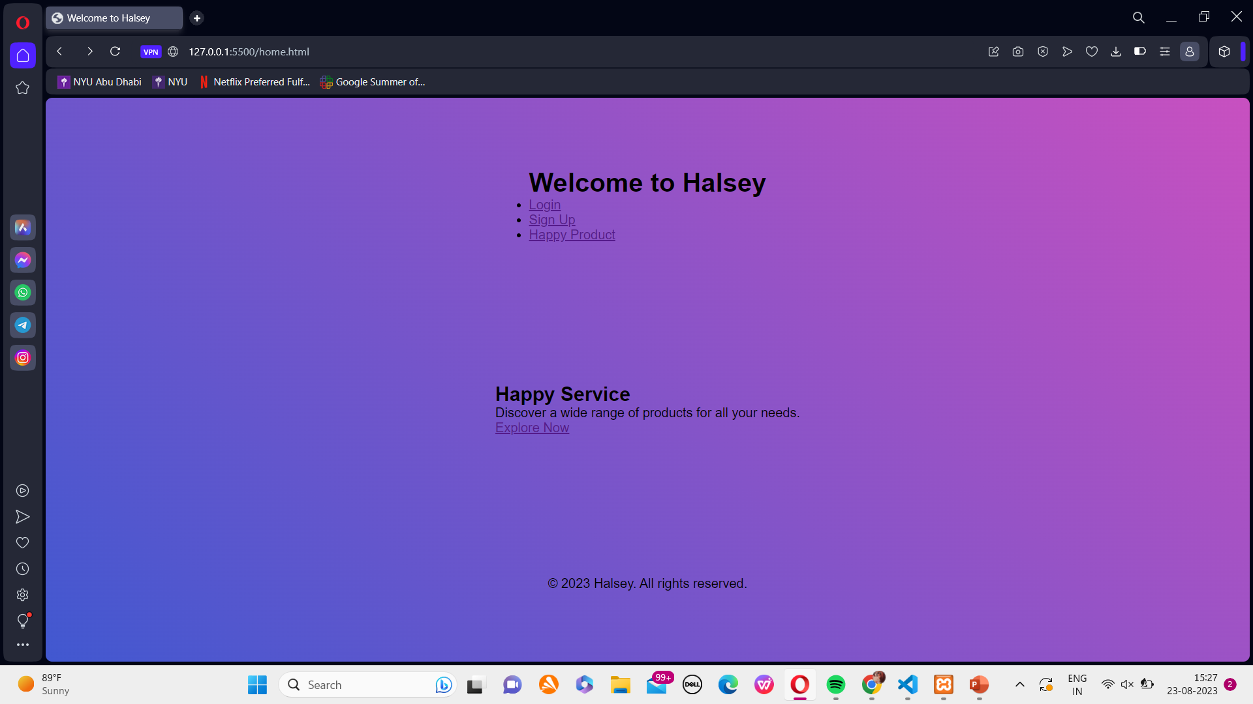
HOME PAGE LOOK

Slide 3
WHAT USER CAN DO IN LOGIN
Log In: Enter credentials (email/username and password) to access their account.
Forgot Password: Reset their password if forgotten, usually through an email link.
Remember Me: Option to save login info for future visits.
Sign Up: Create a new account if they don't have one.

Slide 4
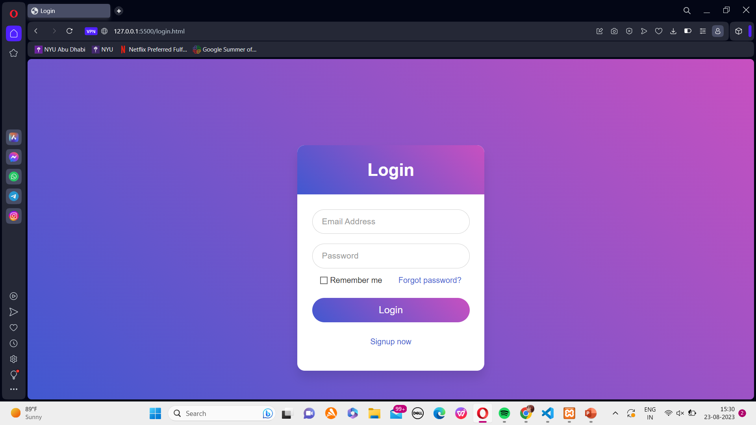
LOGIN

Slide 5
USE OF SIGN UP
Username: A unique identifier chosen by the user for logging into their account and interacting on the platform.
Email: An individual's unique email address, used for communication, account recovery, and
receiving important notifications.
Password: A confidential combination of characters that grants access to the user's account and protects their
personal information.
Confirm Password: A repeated entry of the password during registration to ensure accuracy and prevent typing
errors.

Slide 6
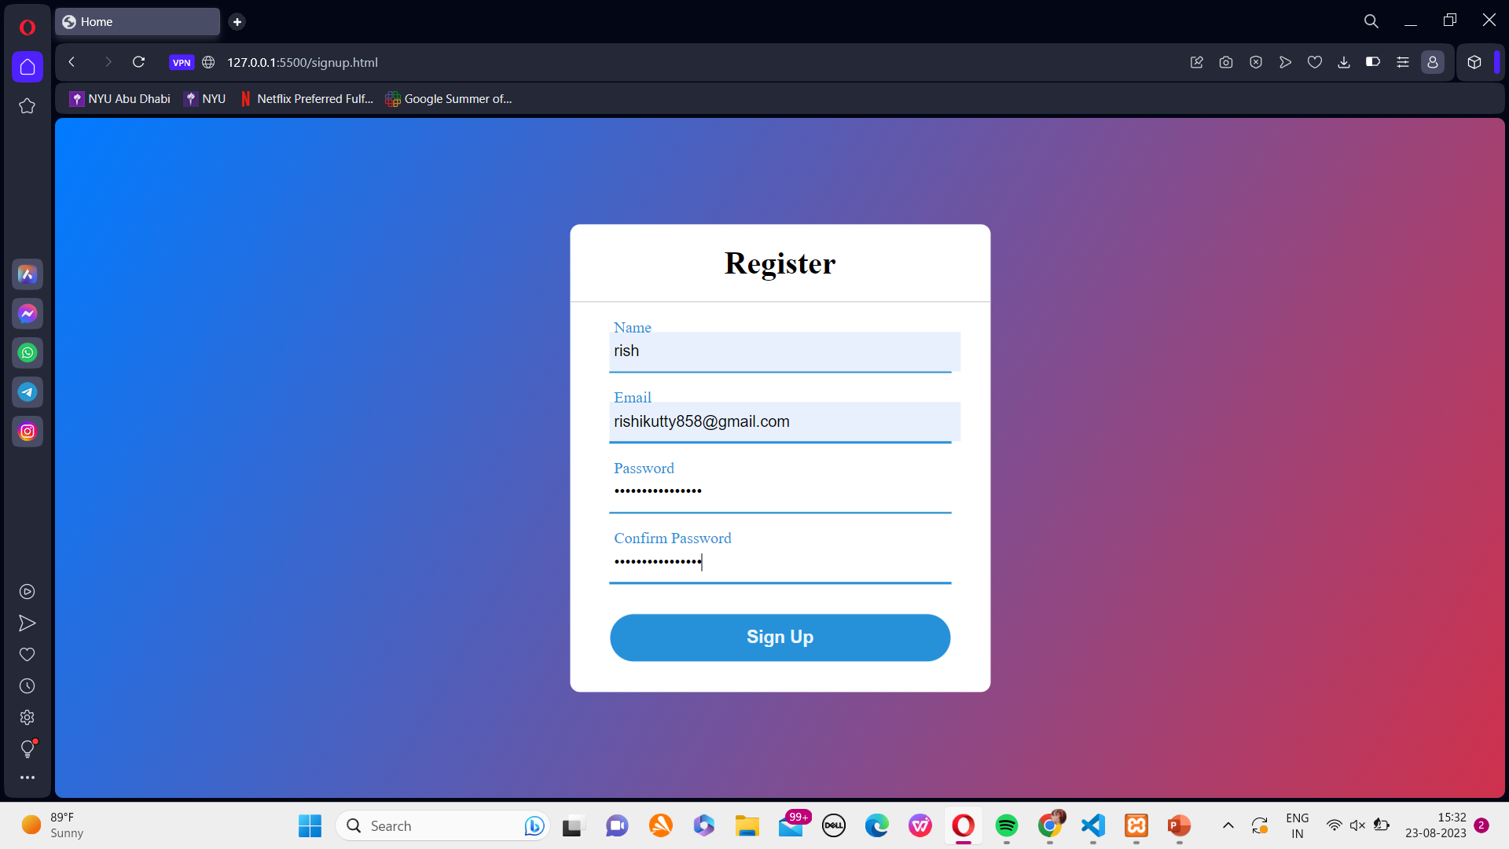
SIGN UP

Slide 7
ABOUT PRODUCT PAGE
Price: Find the cost of the product.
Add to Cart: Place selected products in the shopping cart.
Quantity: Specify how many of a product to purchase.
Buy: Proceed to the checkout process for purchase.

Slide 8
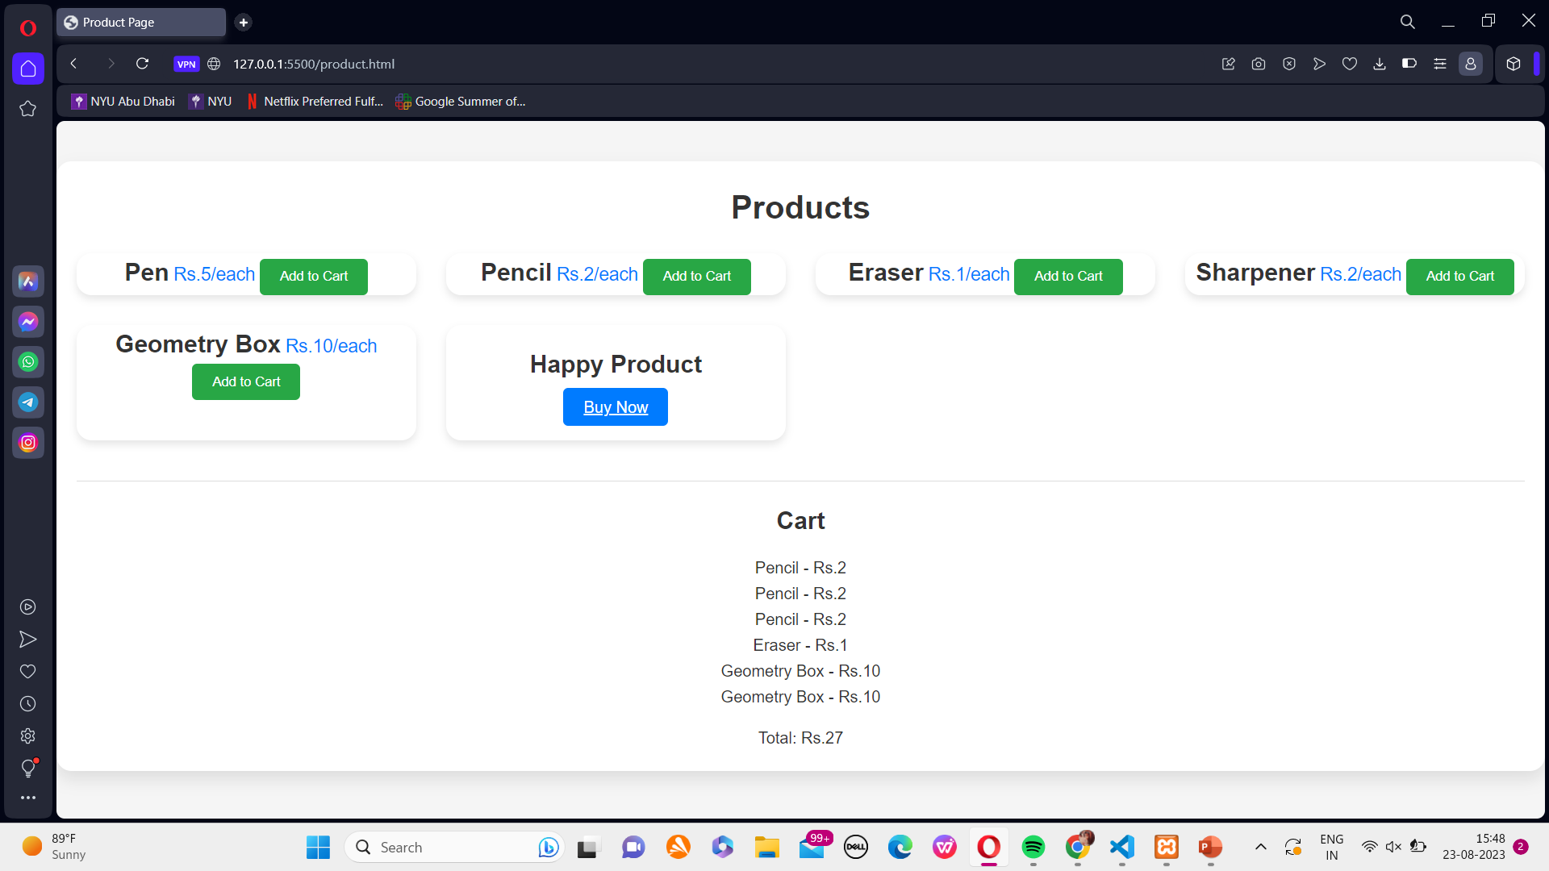
PRODUCT

Slide 9
BUY NOW PROCESS
There are two payment options within the "Buy Now" process:
PAY WITH CARD
PAY ON DELIVERY

Slide 10
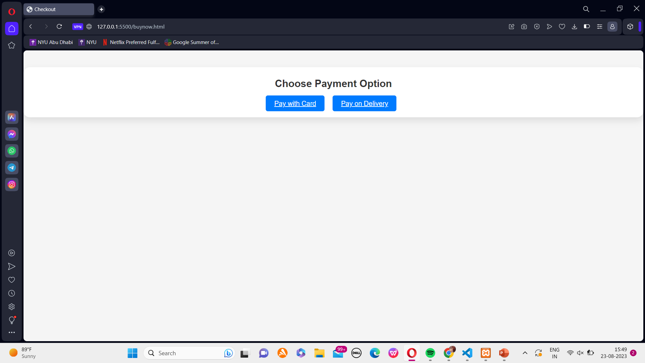
BUY NOW PAGE

Slide 11
PAY WITH CARD
Use a credit or debit card to make instant online payments.
Enter card details and CVV code securely.
Fast, convenient, and suitable for immediate purchases.
Offers electronic receipts for transactions.

Slide 12
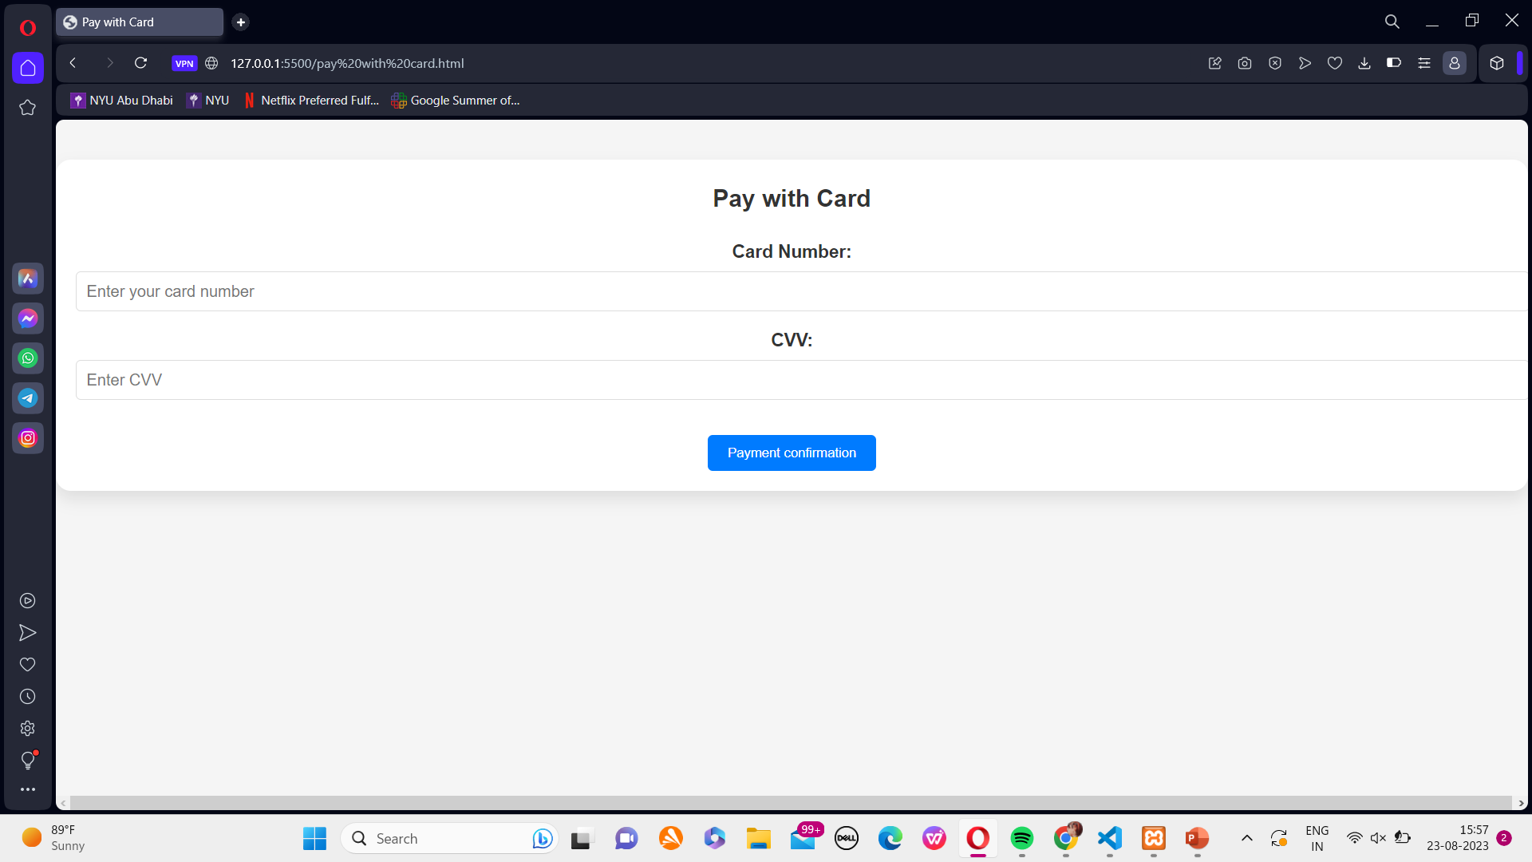
PAY WITH CARD PAGE

Slide 13
PAY ON DELIVERY
Choose to pay in cash or card upon product delivery.
Provides an option to inspect the product before payment.
Suitable for customers who prefer not to share card details online.
May have a delivery fee associated.
Requires coordination with delivery personnel for payment collection.

Slide 14
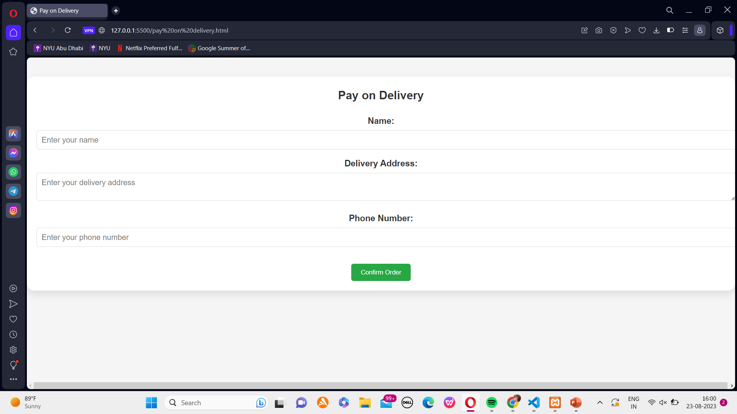
PAY ON DELIVERY

Slide 15
PAYMENT CONFIRMATION
The order is placed successfully.

Slide 16
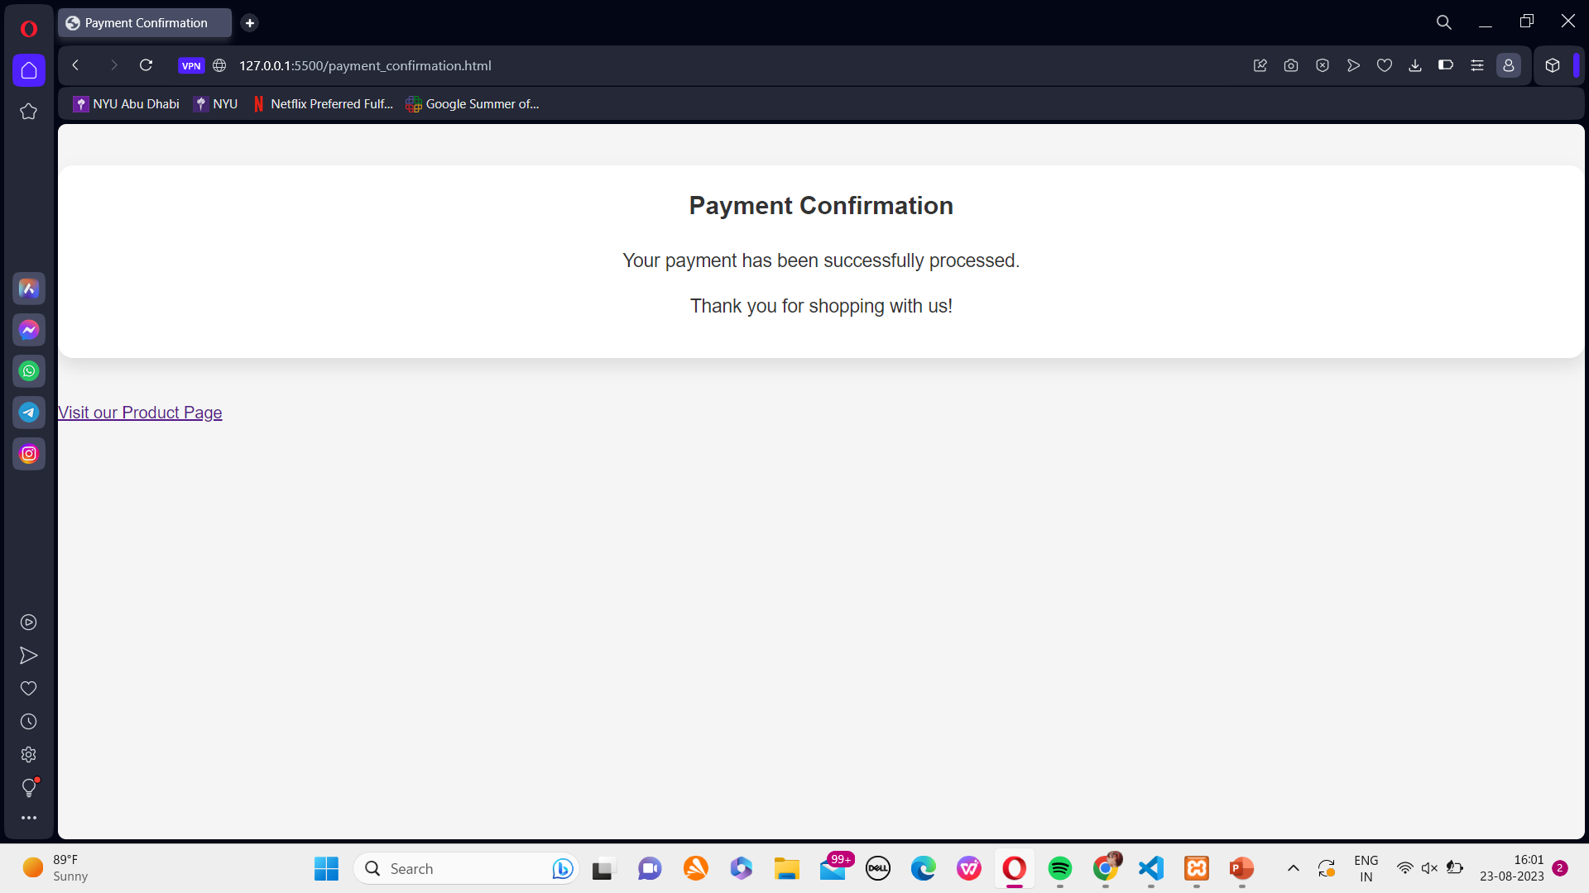
PAYMENT CONFIRMATION PAGE

Slide 17
ADMIN SIDE
Profit Tracking: Admin can access a dashboard displaying profit metrics.
Cost Analysis: Evaluate expenses related to production, shipping, etc.
Profit Calculation: Deduct costs from revenue to calculate profits.
ADMIN CAN SEE THERE PROFITE AT VISIT THE WEBISTE WITH THERE ACCESS PASSWORD

Slide 18
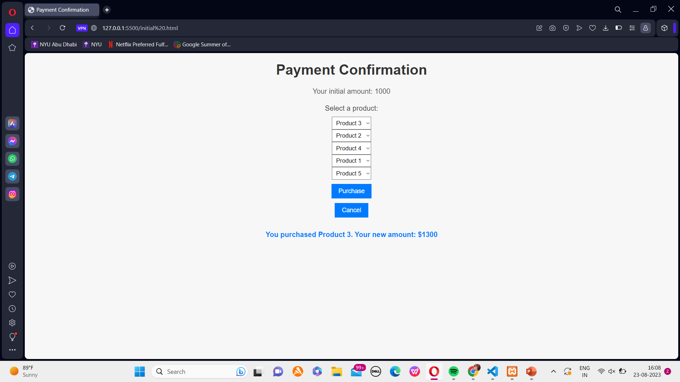
ADMIN

Slide 19
THANK YOU

